Slide 1
Influence of High-Sugar Diets on β-Amyloid Aggregation and Alzheimer’s Onset and Progression in Caenorhabditis elegans
BI Capstone Presentation
Lauren Cohn and Victoria Maselle
Walton High School
Notes:
Victoria
Good evening, and thank you for being here. We are Lauren Cohn and Victoria Maselle, and for our capstone project, we explored whether glucose exposure could influence Alzheimer’s related pathology in C. elegans, a model organism commonly used in neurodegeneration research.

Slide 2
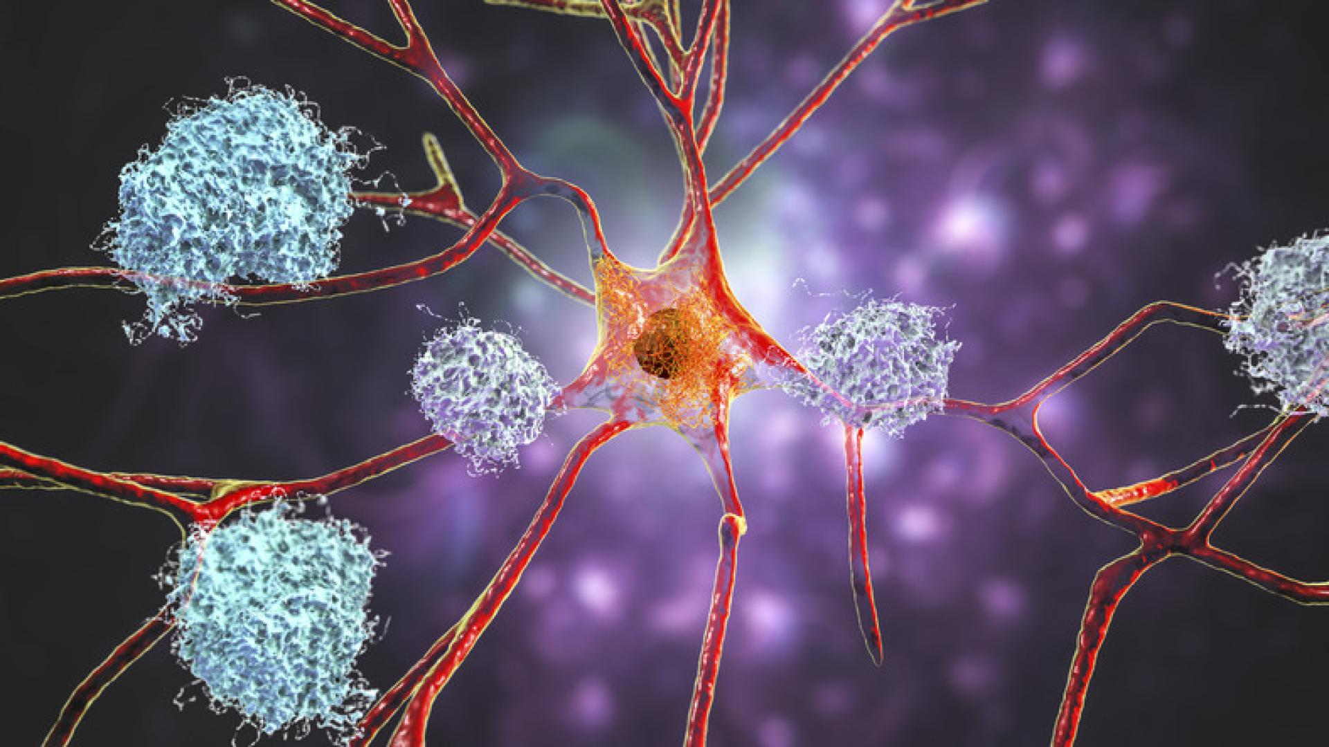
Background
What is Alzheimer’s?
Progressive neurodegenerative disorder affecting memory, thinking, and behavior
Associated with β-Amyloid (Aβ) plaques and tau protein tangles in the brain
(Yeung et al., 2021)
Notes:
Lauren
As of 2026, 7.4 million Americans are living with Alzheimer’s dementia, with the projected numbers to reach 13.8 million by 2060, according to Alzheimer’s Association.
Alzheimer’s disease is a progressive neurodegenerative disorder that affects memory, thinking, and behavior. In this image, you can see two hallmark features of the disease. [point with laser].
Beta amyloid, shown in blue, which is a fragment of a much larger transmembrane protein called the Amyloid Precursor Protein. When these sticky fragments clump together into plaques, they accumulate outside neurons, which can disrupt communication between brain cells, trigger inflammation, and contribute to toxicity.
The other hallmark is tau protein which are shown in orange inside the neuron. These normally help stabilize internal cell structure, but in Alzheimer’s, tau becomes abnormal and forms tangles, which impair transport within the neuron and further damage cell function.
Together, these processes lead to neuronal death, brain atrophy, and progressive cognitive decline. Because beta amyloid aggregation is one of the earliest and most studied features of Alzheimer’s, we decided to focus on that process in our study.
Picture: Tau tangles (orange) inside a brain cell (neuron) and amyloid plaques (blue) in the surrounding area.
Picture from: https://www.brightfocus.org/resource/what-are-alzheimers-plaques-and-tangles/
Alzheimer’s disease (AD) is a neurodegenerative disease that is caused by the abnormal buildup of proteins, amyloid and tau, in the brain. Over time, this buildup damages and kills brain cells, causing parts of the brain to shrink (neuronal death), progressive memory loss, and accelerated cognitive decline. AD’s pathology is explicated by the tau neurofibrillary tangles and the accumulation of β-amyloid into toxic plaques, leading to a disruption in neuronal function and brain atrophy. The β-Amyloid (Aβ) protein plaque accumulation and tau proteinopathy are two prominent processes that define AD (Breijyeh, Z., & Karaman, R., 2020).
Aβ peptides are produced in the amyloidogenic pathway, which is a two-step process. First, the amyloid precursor protein (APP) is cut by beta-secretase and then by gamma-secretase. This cut releases sticky Aβ peptides, which can fold and clump into fibrils, depending on the way it is cut (O’Brien, R.J., & Wong, P.C., 2011). These fibrils can damage brain cells by breaking into smaller, toxic pieces, called oligomers, which are believed to play a big role in the progression of AD. Amyloid fibrils form from two filaments twisted together, with each filament made of stacks of Aβ42 monomers arranged in a β-sheet structure (Fatafta et al., 2021; Lattanzi et al., 2021). This two-filament structure is very stable due to hydrophobic interactions, and without the breakdown of the filaments, there would be a toxic buildup of Aβ42 fibrils and oligomers. The fibrils and oligomers are considered toxic because they block communication between neurons, cause inflammation, and trigger tau tangles, which are all linked to AD (Lattanzi et al., 2021).
An aggregation of Aβ in the brain triggers tau pathology. First, the Aβ increases the chances that glutamate is released into the synaptic cleft. This increased frequency of glutamate release leads to excessive activation of NMDARs (N-methyl-D-aspartate receptors), which are crucial for synaptic plasticity, so the persistent, low-frequency NMDAR activation weakens synapses and causes an influx of LTD-associated kinases (Taylor, H et al., 2021). These chronically activated kinases phosphorylate the tau protein at specific pathological sites. This hyperphosphorylation causes the tau proteins to detach from microtubules, destabilizing the tau so it aggregates together into toxic paired helical filaments and straight filaments that form neurofibrillary tangles (NFTs). Also, the unstable microtubules cannot transport cellular components along the axon, disrupting neuronal function (Wei et al., 2021). The toxic tau will spread between neurons, spreading the pathology, and it causes neuroinflammation, which further contributes to neuronal damage and cognitive deficits. Overall, tau proteinopathy contributes to the progression of cognitive decline, memory impairment, and AD (Chen & Yu, 2023; Kellar & Craft, 2020).

Slide 3
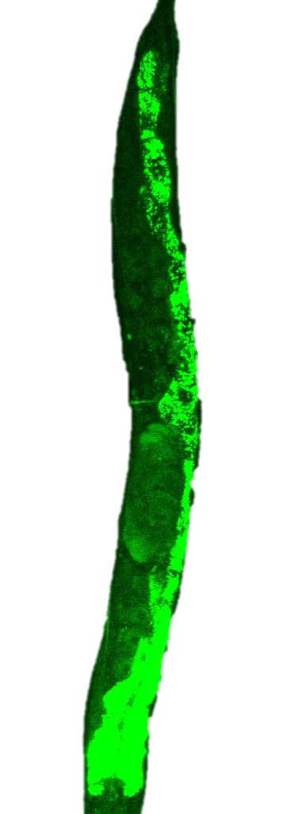
Background
C. elegans share a metabolic and neurodegenerative pathway most similar to humans (Alvarez et al., 2022).
The fluorescence in the Aβ proteins will track the accumulation across C. elegans’ life (Toseland, 2013)
Notes:
Lauren
We decided to use Caenorhabditis elegans, or C. elegans, as our model organism. These are small nematodes widely used in biomedical research.
Although they are much simpler than humans, these worms share important metabolic and neurodegenerative pathways relevant to Alzheimer’s disease, including pathways involved in beta amyloid toxicity, protein aggregation, and cellular stress responses.
This specific transgenic strain was engineered to express fluorescently tagged beta amyloid, allowing us to directly visualize aggregate accumulation over time.
Another advantage of C. elegans is that they have a short lifespan and can be age synchronized, meaning all worms begin the experiment at the same developmental stage. That made them an efficient and controlled model.
Because C. elegans share a metabolic and neurodegenerative pathway most similar to humans, they can model human neurodegenerative diseases such as AD and their relationship to dietary timing.
C. elegans share key pathways, including amyloid precursor protein processing, tau protein regulation, and tryptophan metabolism, which allow them to model toxicity, protein aggregation, and metabolic impairment
Caenorhabditis elegans are nematodes that share signaling pathways most similar to ones in human AD, including the pathways relevant to Aβ accumulation and tau protein dysfunctionality. Transgenic C. elegans strains that express Aβ develop behavioral assays through paralysis to exhibit the Aβ toxicity occurring (Lublin et al., 2011). With the use of age synchronization techniques through bleach treatments, C. elegans will begin the experiment in identical developmental stages (Porta-de-la-Riva et al., 2012). Furthermore, technologies such as a fluorescent CRISPR can be used to tag Aβ proteins, allowing for visualization of accumulation and aggregation patterns as they occur and escalate throughout C. elegans' lifespan (Toseland, 2013).

Slide 4
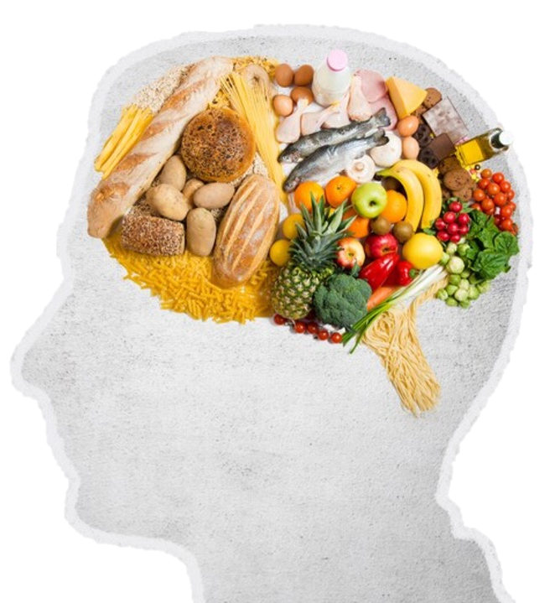
Increased β-Amyloid aggregation
Background
High sugar diets
Note. Adapted from Food for thought. Food in shape of a brain, by Tijanap, n.d., Dreamstime.
Increased risk of developing Alzheimer's disease (AD)
(Yeung et al., 2021; Agarwal et al., 2023; Taylor, M et al., 2017)
Notes:
Lauren
picture from: https://www.dreamstime.com/stock-photography-food-shape-brain-image29936792
45% of of dementia cases worldwide could be prevented or delayed with lifestyle changes.
Previous studies have established diet as a major risk factor.
Previous studies have linked high sugar intake to metabolic dysfunction, insulin resistance, and inflammation. These conditions may promote beta amyloid accumulation while reducing the body’s ability to clear it.
Both human and animal studies have associated excessive sugar consumption with higher amyloid burden and earlier neurodegenerative decline.
Diet is a modifiable environmental factor
High sugar intake is linked to metabolic dysfunction
Insulin resistance and inflammation can increase Aβ buildup
Higher Aβ burden is associated with greater AD risk
Prior studies support this link
But timing of sugar exposure is still unclear
That gap led to your experiment
Research presents how Aβ is a strong indicator for AD risk, highlighting the importance of understanding to what degree environmental factors influence Aβ pathways.
Diet is an environmental factor that can be modified to change neurodegenerative onset, progression, and severity. Diets high in sugar are seen to increase oxidative stress and metabolic malfunction of which promotes tau pathology and Aβ accumulation. Animal studies have demonstrated that excessive dietary sugars worsen attributes of neurodegeneration, increase Aβ neural toxicity, and impede locomotor performance, linking metabolic stress to neurodegeneration in AD (Sharma et al., 2023; Rodríguez-Antolín et al., 2017). Human studies also support this deliberation as individuals who consume diets high in sugar contain a higher Aβ aggregation and an earlier onset of AD, which centralizes the idea of diets' influence on early neurodegenerative disease development (Agarwal et al., 2023; Taylor, M et al., 2017). Recent research implies that early dietary environments are fundamental to priming neurons and metabolic pathways that change vulnerability to later neurodegeneration. In mouse models, high sugar environments introduced in the middle of adulthood trigger inflammatory responses and amyloid changes that expose a risk to extensive diseases (Baranowski et al., 2018). Although there is strong evidence of sugar contributing to Aβ aggregation and the onset of AD, there is little known about how timing of high sugar consumption, specifically differences in age, changes the onset or susceptibility of AD progression.
Studies show that elevated sugar levels, especially fructose and sucrose, are associated with higher beta amyloid levels (van Gils et al., 2024; Agarwal et al., 2023). Excess sugar intake causes the pancreas to produce more insulin, but eventually, the cells become desensitized, causing them to not open up to glucose effectively. This causes insulin resistance, where the body’s cells don’t respond properly to insulin. Insulin resistance lowers levels of insulin-degrading enzyme (IDE), which is responsible for breaking down Aβ. Insulin resistance also increases the activity of β-secretase (BACE1) enzymes that cleave the amyloid precursor protein (APP) into Aβ peptides. Insulin resistance is also linked to increased inflammation, which can upregulate Aβ peptides. The accumulation of Aβ then further worsens insulin-resistant patients, further progressing AD (Wei et al., 2021; Agarwal et al., 2023).

Slide 5
It remains unclear whether glucose exposure during early adulthood affects β-Amyloid aggregation and behavioral decline in C. elegans.
Problem Statement
Notes:
Lauren
however, it is unknown at which stage of life sugar exposure influences the progression of AD
High sugar diets have been associated with increased Alzheimer’s disease risk, yet it remains unclear whether early glucose exposure influences β amyloid aggregation and behavioral decline. This study examined how glucose exposure beginning at the L4 stage affects these outcomes in C. elegans.

Slide 6
Glucose exposure beginning at the L4 stage has no effect on Aβ aggregation or behavioral decline in C. elegans compared with worms grown on control NGM plates.
Null Hypothesis
Notes:
Lauren
Our null hypothesis was that glucose exposure would produce no significant difference in aggregate burden or behavioral outcomes between treatment groups.
In other words, any differences observed would be due to normal variation rather than a true treatment effect.

Slide 7
Following heat shock induced Aβ expression, C. elegans exposed to glucose from the L4 stage onward will develop greater Aβ aggregation and increased paralysis compared with control worms.
Alternative Hypothesis
Notes:
Lauren
We predicted that glucose exposed worms would show greater aggregate burden and reduced movement compared with controls, based on previous sugar and Alzheimer’s research

Slide 8
What influenced our experiment design
Literature review revealed timing-of-sugar research gap in AD
Dr. Katz and Dr. Mondoux collaboration refined final glucose imaging design.
Notes:
Lauren
Our experiment was shaped by both literature and mentorship.
Through our literature review, we found strong evidence connecting sugar intake to Alzheimer’s related pathology such as AB aggregation, but a [gap] smaller amount of research on whether the timing of exposure changes outcomes.
That gap inspired our original question.
Many studies examined whether high sugar diets increase Alzheimer’s related risk, but fewer explored whether the timing of sugar exposure during development or adulthood may also matter. That became our original research question.
Later, while working at Emory, Dr. Katz connected us with Dr. Michelle Mondoux, who is conducting a similar glucose-based paralysis study. Since her group had not yet focused on aggregate imaging, we adjusted our design to use glucose and contribute imaging data that could align with the broader project.
allowing our work to complement a larger research effort.
Before starting our experiment, we completed an extensive literature review on Alzheimer’s disease, β amyloid aggregation, dietary sugar, and the use of C. elegans as a neurodegeneration model. From that research, we noticed that while many studies linked high sugar diets to increased Alzheimer’s risk, fewer addressed whether the timing of sugar exposure during life stages changes disease progression. That originally inspired our project question.
Later, when we visited Emory to perform our experiment with Dr. Katz, Monica, and Mackenzie, Dr. Katz shared that his colleague Dr. Michelle Mondoux at Holy Cross was conducting a very similar study using glucose and paralysis assays. She had not yet examined aggregate imaging, so she asked if we could collect imaging data that could contribute to her broader study. Because of that collaboration opportunity, we adjusted our design from using sucrose or fructose to using glucose so our data would align with her methods and could potentially be combined in a publication.
Literature review identified a gap on how timing of sugar exposure may influence Alzheimer’s related pathology in C. elegans
Guidance from Dr. Michelle Mondoux and Dr. David Katz refined our design to use glucose and collect aggregate imaging data alongside paralysis outcomes.

Slide 9

PPE worn
Sterile technique used
Care with heat and equipment
Workspace sanitized
Proper waste disposal
Autoclave
Safety Precautions Taken
Notes:
Victoria
Throughout the experiment, we followed standard laboratory safety procedures. We wore gloves and protective equipment when preparing media, handling worms, and working with chemicals. Sterile technique was important to prevent contamination of the plates and bacterial cultures. We also used caution around hot agar, autoclaved materials, microscopes, and glass slides. After each session, we cleaned the workspace and disposed of materials according to lab protocols.
Levamisole handled carefully in small amounts
Hot agar during plate pouring
Biological waste disposed properly
Slides and coverslips handled carefully to avoid breakage
Hands washed after lab work

Slide 10
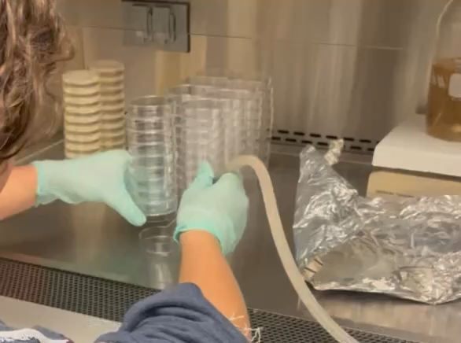
Pour Plates
Steps
25°C NGM
15°C NGM
25°C Glucose
15°C Glucose
Notes:
Victoria
Made NGM mix --> autoclave
Made Glucose mix --> mix with stir stick
After autoclaved and mixed, added glucose mix, cholesterol, CaCl2, MgSO4, and KH2PO4 to agar mix (liquid). (agar mix is cooled after 20 minutes room temp)
Poured the plates – 10mL per 6mm plates (made ~100 plates). She made ~90.
Let cool room temp 4-5 days
plates = treatment environment
control vs glucose comparison
25°C needed for gene activation
consistency reduces error
foundation for all later results
We began by preparing the treatment plates that would serve as the worms’ environment throughout the experiment. This step was critical because the composition of each plate determined the condition each group experienced. We created control NGM plates and glucose plates so we could isolate the effect of glucose exposure. We also prepared plates for both 15°C and 25°C conditions, since this worm strain requires heat shock at 25°C to induce expression of the β amyloid gene. Keeping plate preparation consistent, including equal volumes poured into each plate, helped control variables so any later differences in aggregation or behavior would more likely be due to treatment conditions rather than inconsistencies in the media.

Slide 11
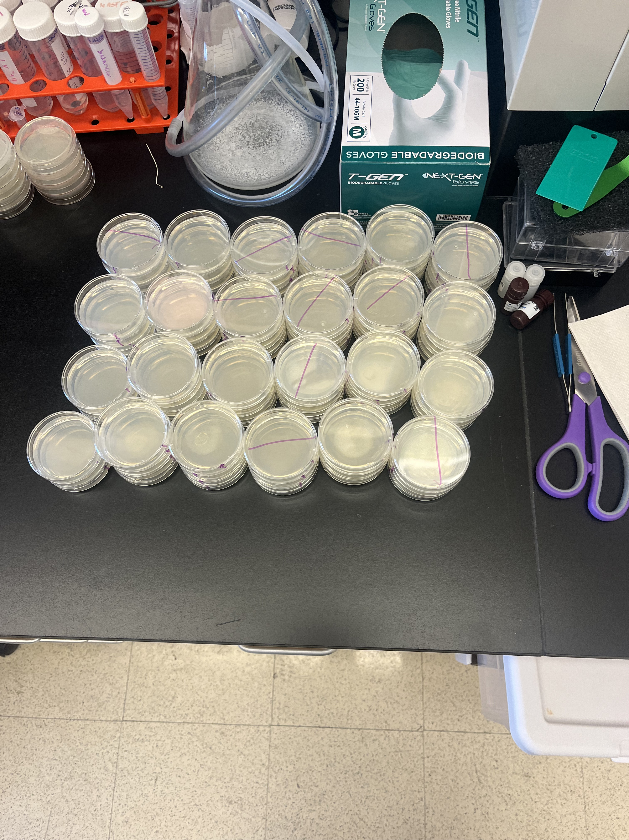
Seed Plates
Steps
Notes:
Victoria
Added 3 drops of E. coli (OP50) bacteria on each plate.
OP50 is standard worm food
worms need food to grow and survive
equal amount on each plate controls nutrition
prevents starvation/confounding variables
isolates glucose as treatment factor
We then seeded each plate with OP50 E. coli, which is the standard food source for C. elegans. We added three drops to each plate so the worms would have a consistent bacterial lawn to feed on throughout the experiment. This step was important because nutrition can influence worm growth, movement, and stress responses. By keeping the food source and amount consistent across all treatment groups, we reduced variability and ensured that glucose in the media, rather than differences in food availability, was the main variable being tested.

Slide 12
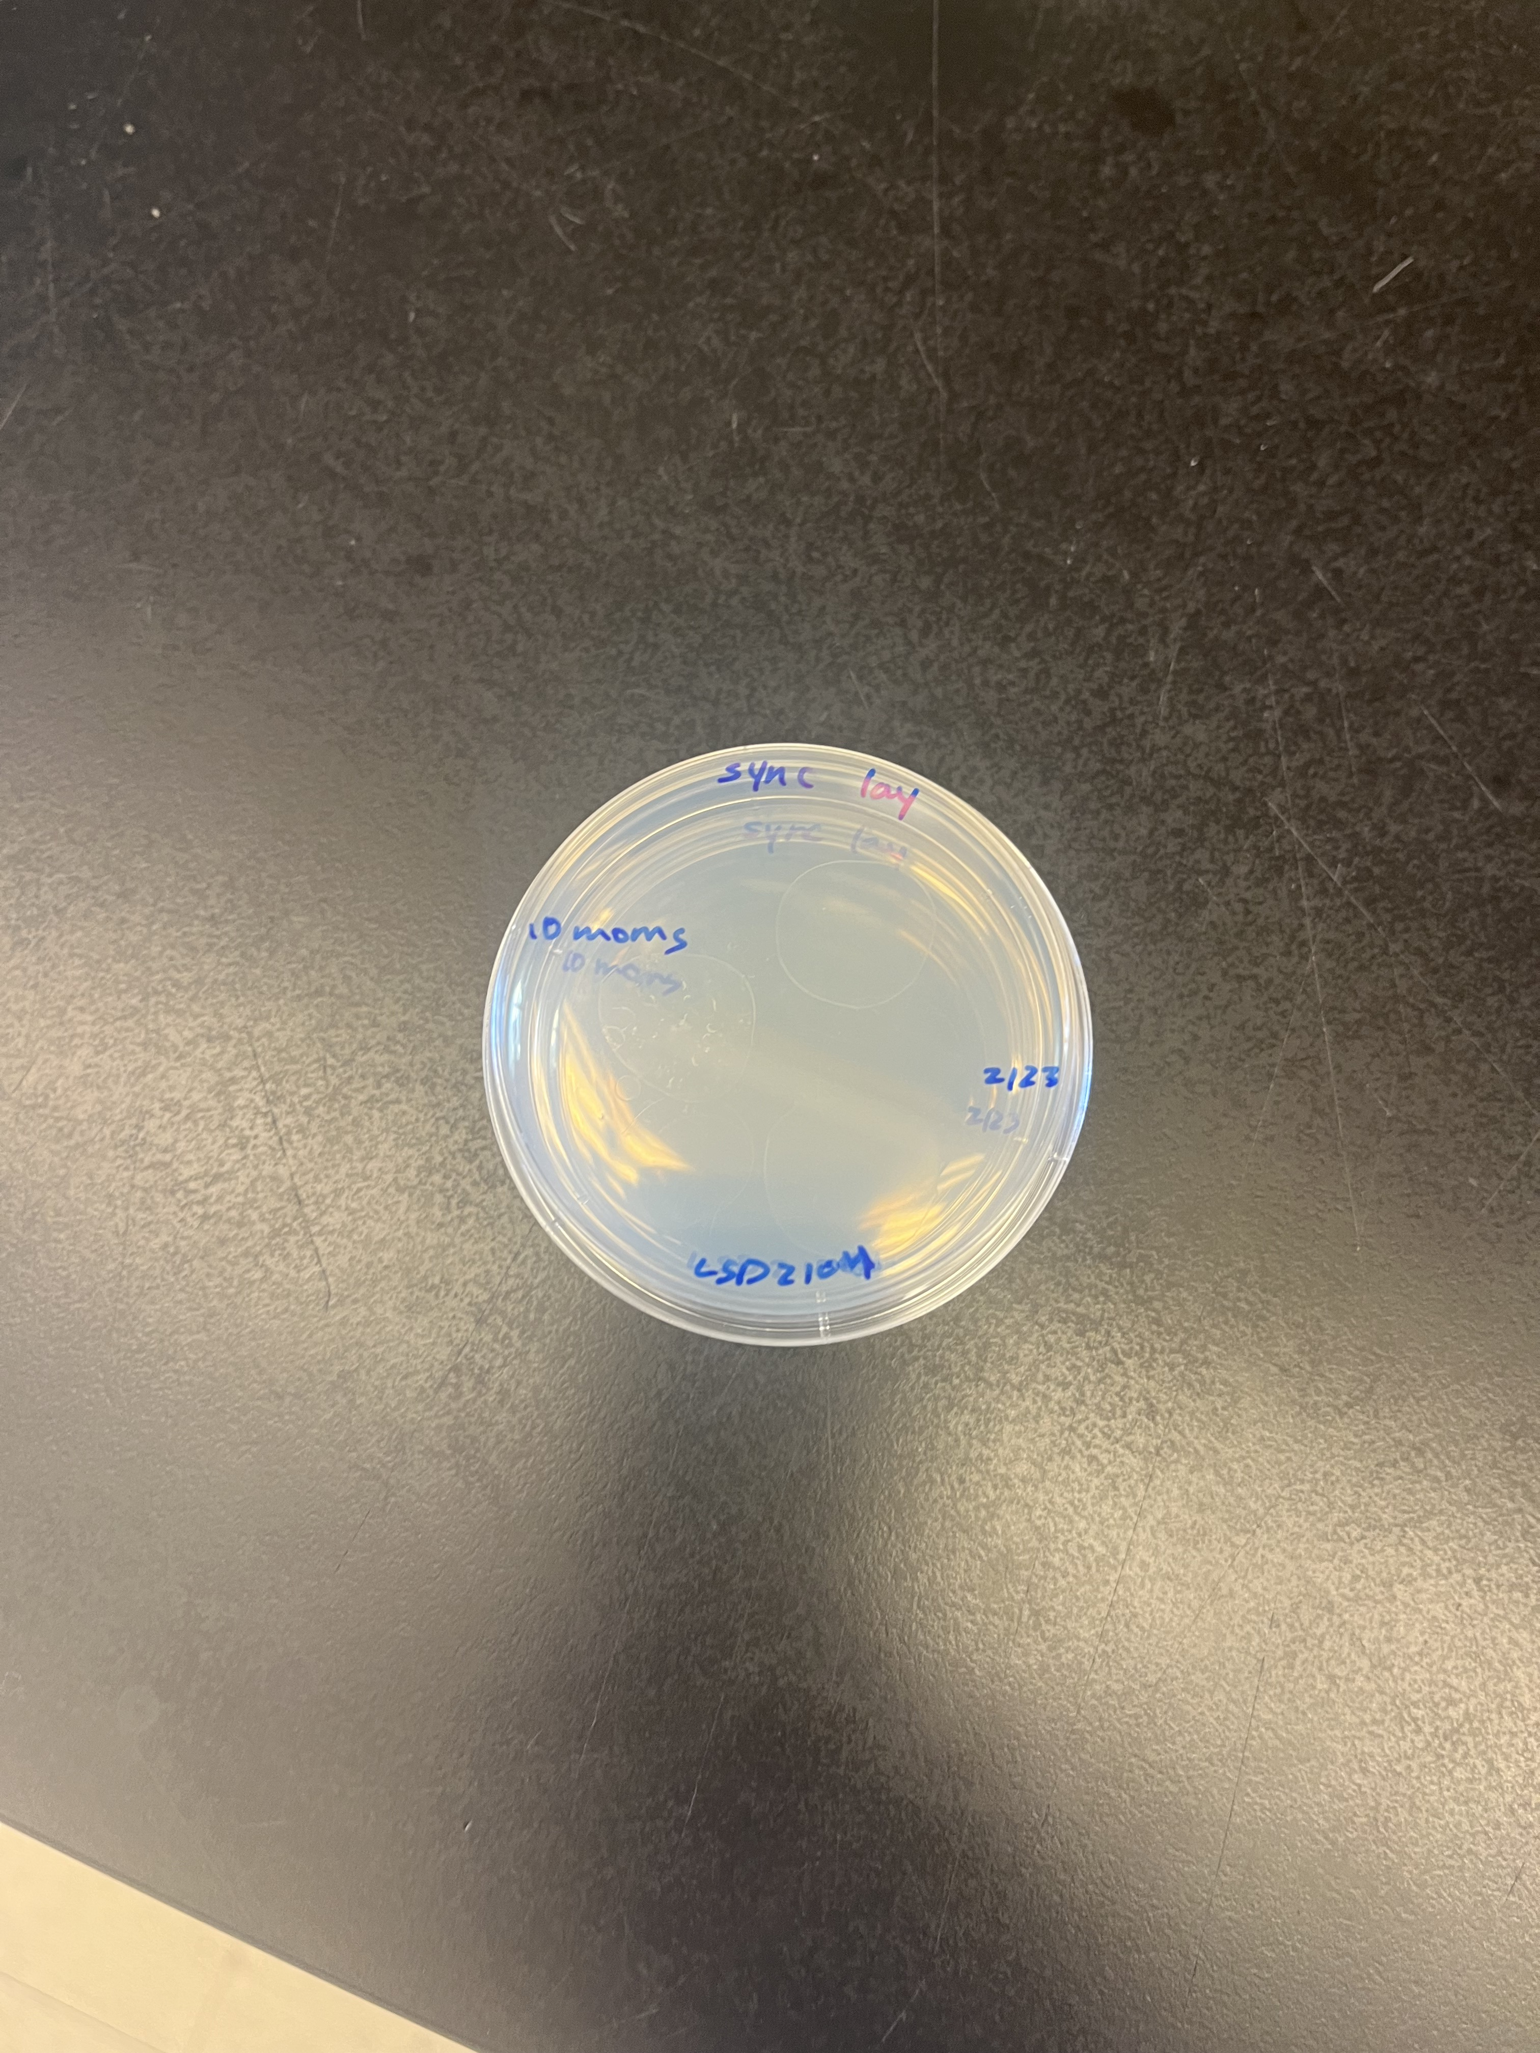
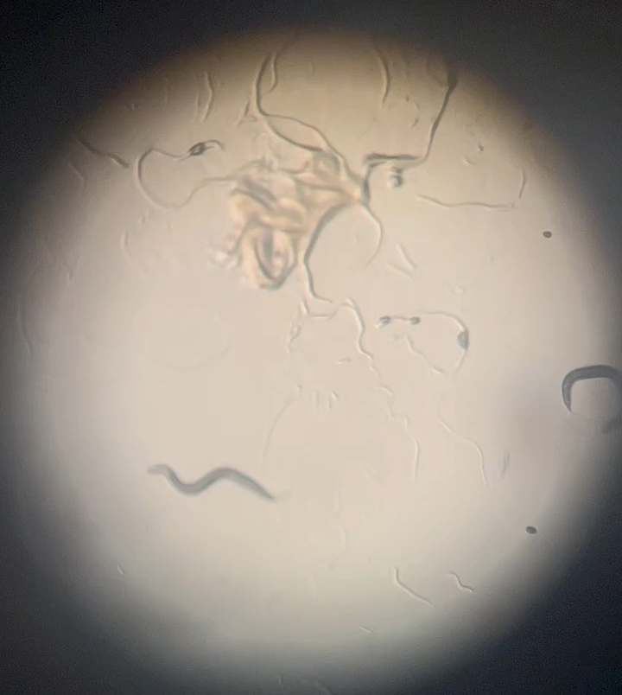
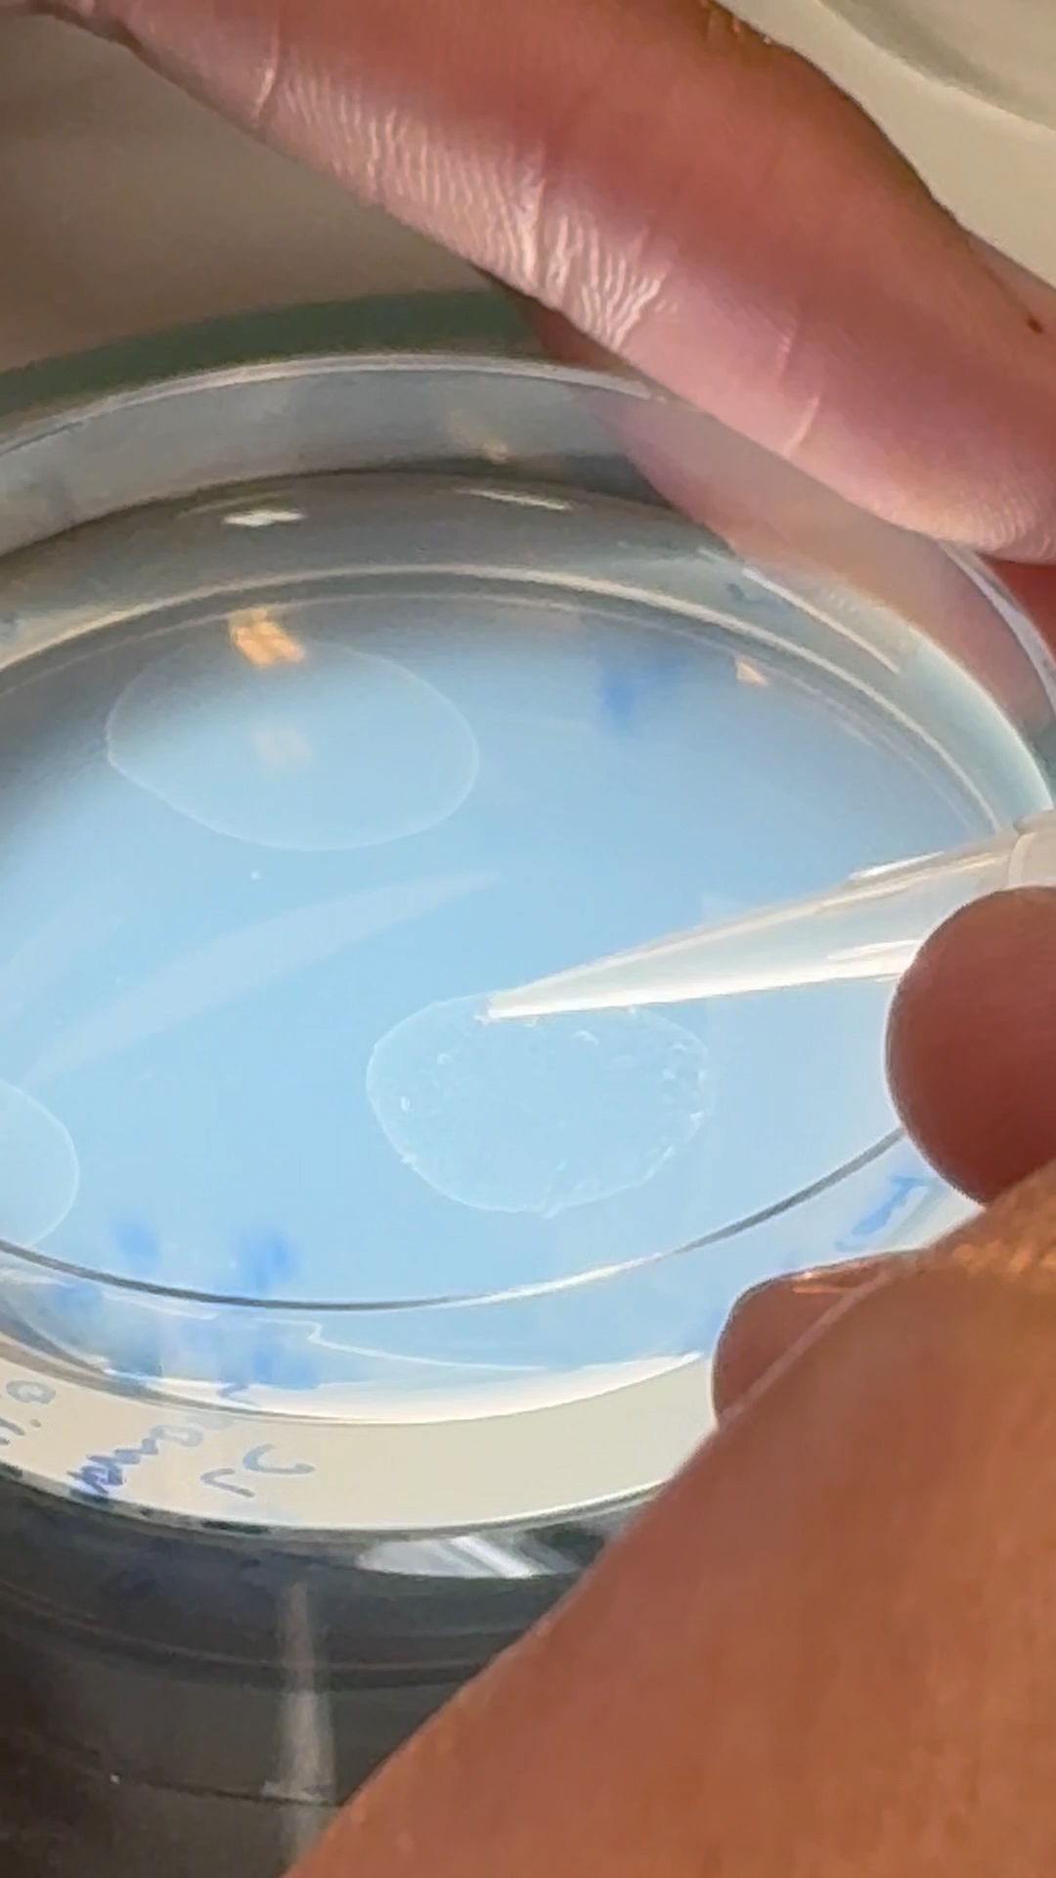
Synchronized Lay
Steps
Notes:
Victoria
Explain why and how:
WHY: we allowed the adult worms to lay eggs during a controlled time window so the offspring would all be the same age. This was important because age strongly affects development, movement, and β amyloid aggregation. By starting with age matched worms, we reduced variability and made comparisons between treatment groups more reliable.
HOW: we placed 10 adult worms onto fresh NGM (no glucose) plates and allowed them to lay eggs for a set period of time. After that window, the adults were removed (far right video), leaving only the eggs behind. Because those eggs were laid at roughly the same time, the worms hatched and developed together as an age matched population.

Slide 13
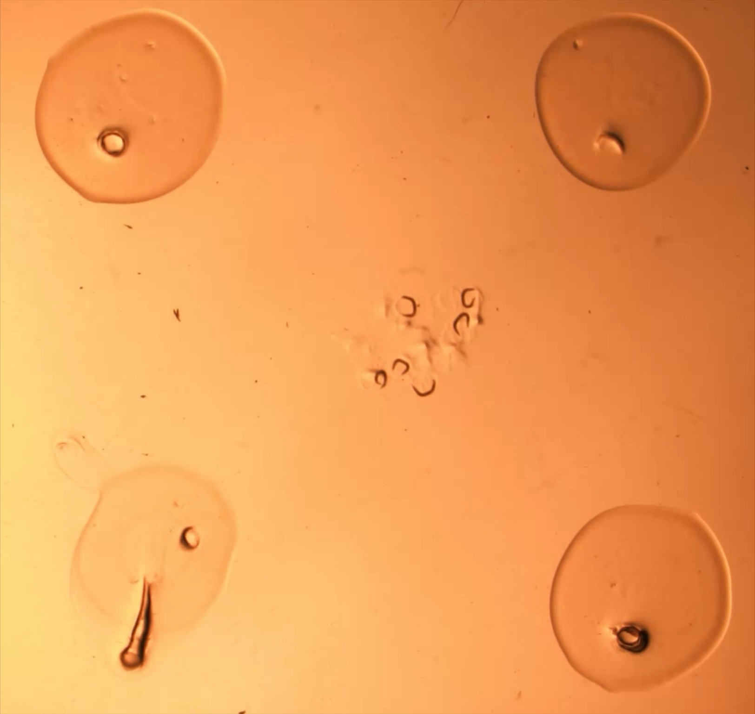
Day 2: Movie Making
Making the plates: chemotaxis
25C Glucose1 10X
Notes:
Lauren
WHY THEN how
To measure behavioral outcomes, we performed motility assays using live worms. Worms were first transferred into M9 buffer wells to wash off bacteria from their plates. They naturally begin thrashing in liquid, which helped clean them before testing.
We then transferred a small group of worms onto assay plates containing a concentrated bacterial spot. That food source created a chemotaxis cue, meaning the worms were motivated to move toward it.
We recorded approximately 20 minute videos and later quantified movement patterns, speed, and paralysis related behavior across treatment groups.
Fill 3 wells with M9
Pick ~5/6 worms from plate to well
They will start thrashing – this will help get them clean (get off all the bacteria they were moving in on the plate)
Move the worms to new well with M9 (use worm “tornado” to go “worm fishing”)
Record thrash count for 1 minute
Move worms to plate to make movies (21 minutes)
Wet worms on plate as you’re trying to transfer to ensure they don’t dry out too fast.
To make plates for movies: 3 μL of concentrated bacteria on agar plate – “spotting”
That’s their chemotaxis motivation to move

Slide 14
Day 2: Movie Making
Making the plates: chemotaxis
25C Glucose1 10X
Notes:
Lauren
To measure behavioral outcomes, we performed motility assays using live worms. Worms were first transferred into M9 buffer wells to wash off bacteria from their plates. They naturally begin thrashing in liquid, which helped clean them before testing.
We then transferred a small group of worms onto assay plates containing a concentrated bacterial spot. That food source created a chemotaxis cue, meaning the worms were motivated to move toward it.
We recorded approximately 20 minute videos and later quantified movement patterns, speed, and paralysis related behavior across treatment groups.
Fill 3 wells with M9
Pick ~5/6 worms from plate to well
They will start thrashing – this will help get them clean (get off all the bacteria they were moving in on the plate)
Move the worms to new well with M9 (use worm “tornado” to go “worm fishing”)
Record thrash count for 1 minute
Move worms to plate to make movies (21 minutes)
Wet worms on plate as you’re trying to transfer to ensure they don’t dry out too fast.
To make plates for movies: 3 μL of concentrated bacteria on agar plate – “spotting”
That’s their chemotaxis motivation to move
*mention in video: they are rollers

Slide 15
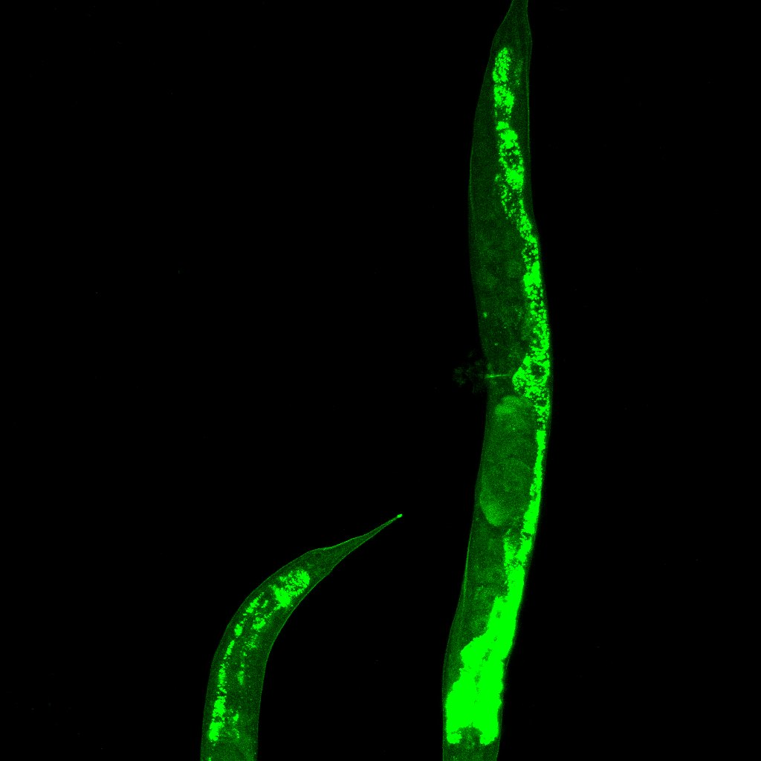
Days 3 and 9: Data Collection Through Imaging
Worms mounted on agarose pads with levamisole to immobilize movement
Confocal fluorescence microscopy
Fluorescent Aβ signal allowed location and intensity visualization of aggregate
25C Glucose Confocal
Notes:
Lauren
Imaging allowed us to directly examine the underlying biology inside the worms.
Because this strain expressed fluorescently tagged beta amyloid, we could visualize where aggregates were forming and estimate their burden over time. This was important because worms might show normal movement while pathology is already developing internally, or movement decline may occur before large visible aggregates appear.
To capture clear images, we mounted live worms on agarose pads and used levamisole to temporarily immobilize them. We then used confocal fluorescence microscopy, which provided higher resolution images and allowed us to detect fluorescent beta amyloid throughout the worm body.
To capture clear images, we mounted live worms onto thin agarose pads placed on positively charged slides so the sample remained stable.
We added levamisole, a temporary paralytic, to immobilize the worms during imaging
This preparation allowed us to image the same worm clearly without motion blur.
We used two microscopy methods to examine aggregate burden.
First, confocal fluorescence microscopy used a laser based optical system to capture multiple layers through the worm body. These layers were reconstructed into a 3D image, allowing us to study aggregate location and distribution throughout the animal.
We also used epifluorescence microscopy to compare visible puncta between treatment groups. Its fluorescence and DIC (Differential Interference Contrast) modes helped us identify true aggregates relative to worm anatomy.
To capture clear images, we mounted live worms on agarose pads and used levamisole to temporarily immobilize them. This prevented movement during imaging. We then used confocal fluorescence microscopy (an advanced imaging technique that enhances resolution and contrast by using a laser to excite fluorescent probes and a pinhole aperture to eliminate out-of-focus light), which allowed us to detect the fluorescently tagged beta amyloid proteins inside the worm.
Pros of Confocal microscopy:
Superior to conventional fluorescence microscopy, offering improved sharpness, especially in thick specimens
High contrast, 3D imaging capabilities, reduced background haze
allows for optical sectioning, enabling the creation of sharp 3D reconstructions of thick, multi-fluorescent specimens, such as biological tissues and cells
Use “plus” slide to make anything stick to it. Because they’re positively charged.
Melt agarose and ~5 drops on slide, immediately put another slide on top (+ side down) to flatten really thin.
Put 5 μL levamisole (paralytic) on agarose pad
Pick worms into levamisole
Gently place cover slip on top
Draw dots around worms (optional) to easily find them later on the confocal scope
Put clear nail polish on edges of coverslip to prevent drying out
Do one slide at a time to prevent drying out.

Slide 16
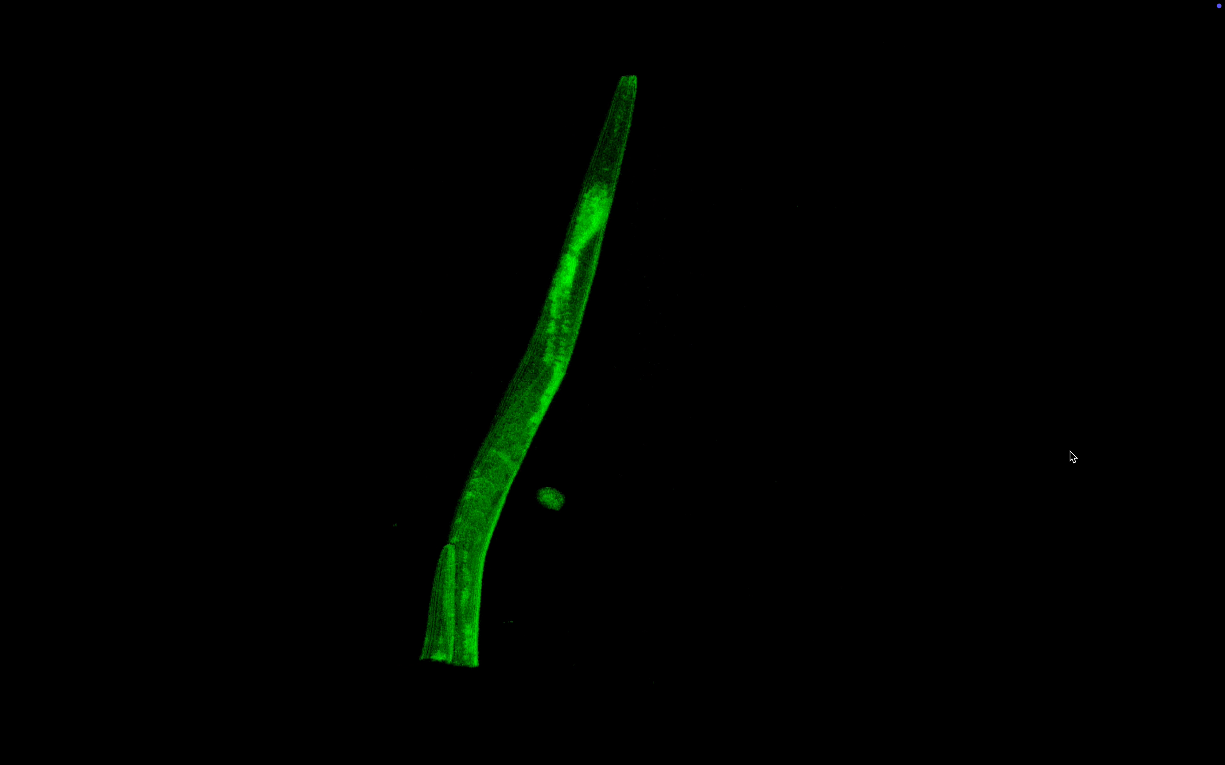
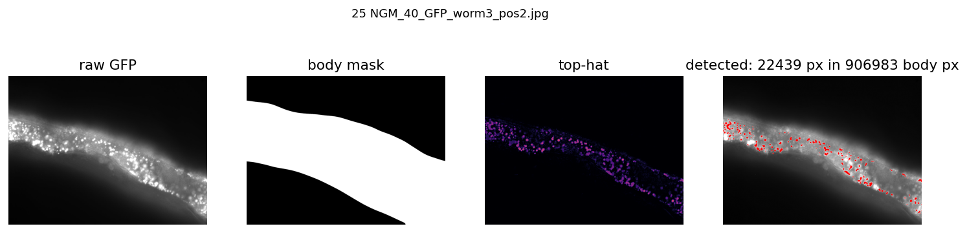
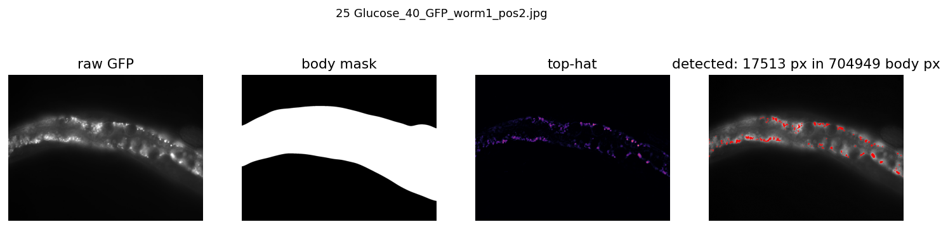
Advanced Imaging and Quantification
Confocal z stack - 3D reconstruction
Epifluorescence imaging (DIC) - puncta across treatment groups
Images compared for aggregate number, size, and distribution
Raw microscopy and video data were quantified using ImageJ, Lolitrack, and Claude assisted analysis workflows
15C NGM Confocal
Notes:
Lauren
We also used epifluorescence microscopy to compare visible puncta between treatment groups. Its fluorescence and DIC (Differential Interference Contrast) modes helped us identify true aggregates relative to worm anatomy
After collecting our raw images and videos, we initially attempted analysis using traditional platforms such as ImageJ and Lolitrack, which had significant workflow limitations including crashes, tracking errors, and inefficient processing.
We then used Claude as an additional computational tool to analyze motility and aggregate patterns. Importantly, we validated those outputs against the original images and videos to confirm accuracy.
Using this approach allowed us to generate more quantitative results efficiently while maintaining data integrity. ImageJ was useful for some visualization outputs, but for high volume tracking and segmentation we needed a more efficient workflow.
We leveraged computational tools, validated outputs, and improved quantitative analysis.
“computational tool, assisted analysis, validated outputs, quantitative processing, image segmentation, motion tracking, efficiency and reproducibility”
Confocal z stack created 3D reconstruction through the worm body
Epifluorescence imaging captured puncta across treatment groups
Images compared for aggregate number, size, and distribution
The confocal microscope captured multiple optical layers through the worm, which were reconstructed into a 3D image. This helped us examine where aggregates were located throughout the body.
Z-stack takes ~60 photos for each layer of the worm from bottom to top. Can do a 3D reconstruction of the worm.
At 60X: put oil directly on lens.
Things to look at when analyzing images: Placement/location of plaques (in gut? Dorsal? Ventral?)
We also used epifluorescence imaging to compare visible puncta between groups and later quantify patterns.
Epifluorescence Microscope with DIC (Differential Interference Contrast) capability
This kind of scope can flip between fluorescence and DIC – helpful to see what you’re looking at (where the puncta are)
100X
Looking for “puncta”
On 25C NGM, mostly all of the GFP is from AB (not autofluorescence)
Note: gut naturally/normally auto fluoresces, but this is too big and distinct that Dr. Katz thinks it’s real.
Outside of gut, not much (in 25 NGM)

Slide 17
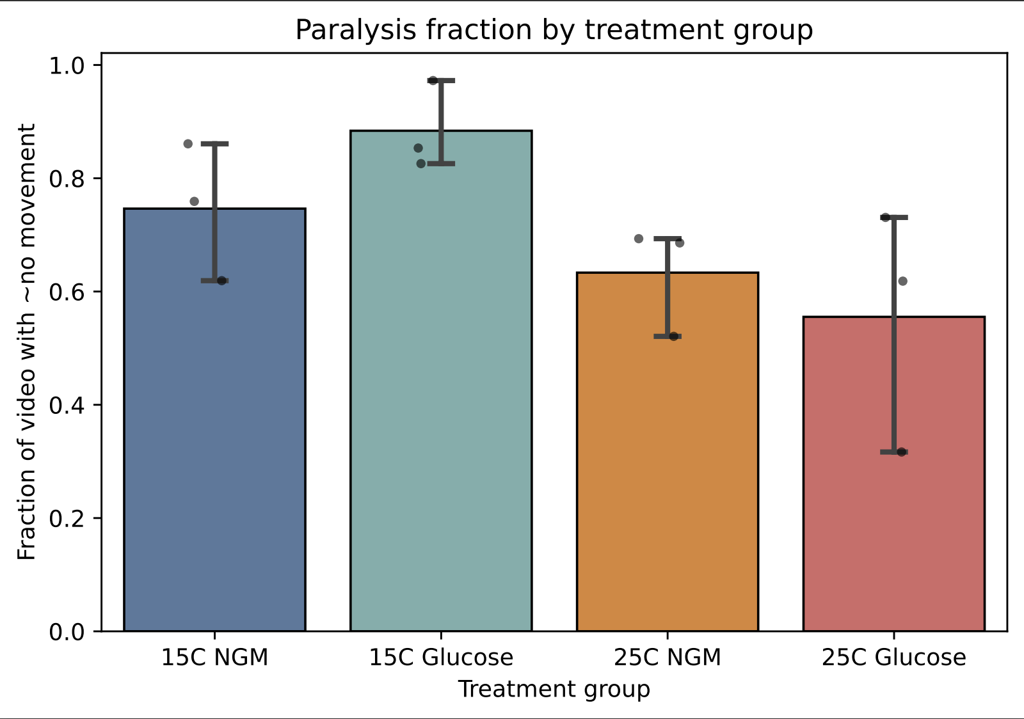
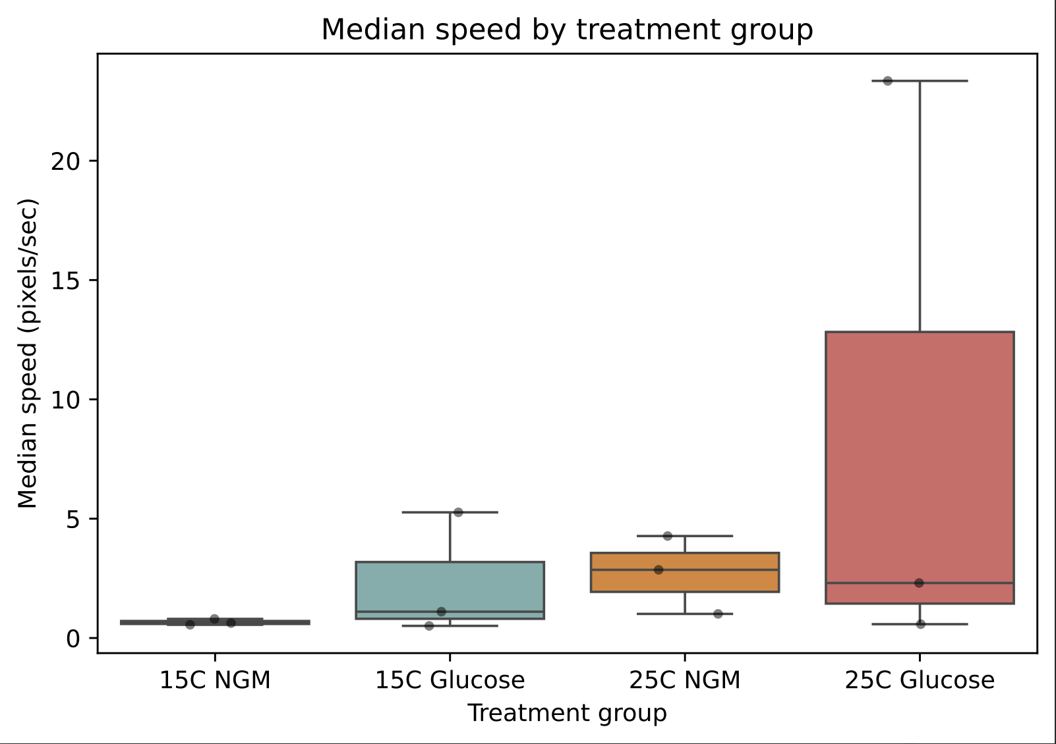
Behavioral Results
15°C groups moved less overall
25°C groups were more active
Glucose did not clearly worsen movement/paralysis
Two-way ANOVA (temp x glucose)
Two-way ANOVA
Notes:
Victoria
After collecting our imaging and behavioral data, we analyzed the results using statistical tests to determine whether any observed differences between groups were meaningful rather than due to chance.
We selected statistical tests based on the type of data collected. For comparisons across temperature and glucose groups, we used two way ANOVA. For imaging datasets with smaller non normal samples, we used Kruskal Wallis testing.
We used a two way ANOVA because this dataset involved two independent variables, temperature and glucose exposure. This allowed us to evaluate both their individual effects and any interaction between them.
Our analysis showed that temperature had a stronger effect on movement than glucose. Worms in the 15°C groups moved less overall, while glucose did not produce a statistically significant change in paralysis or speed.

Slide 18
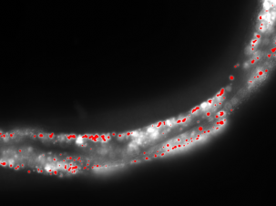
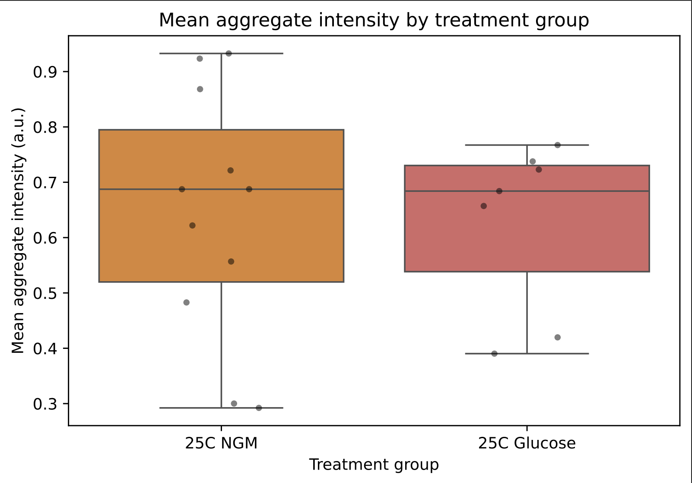
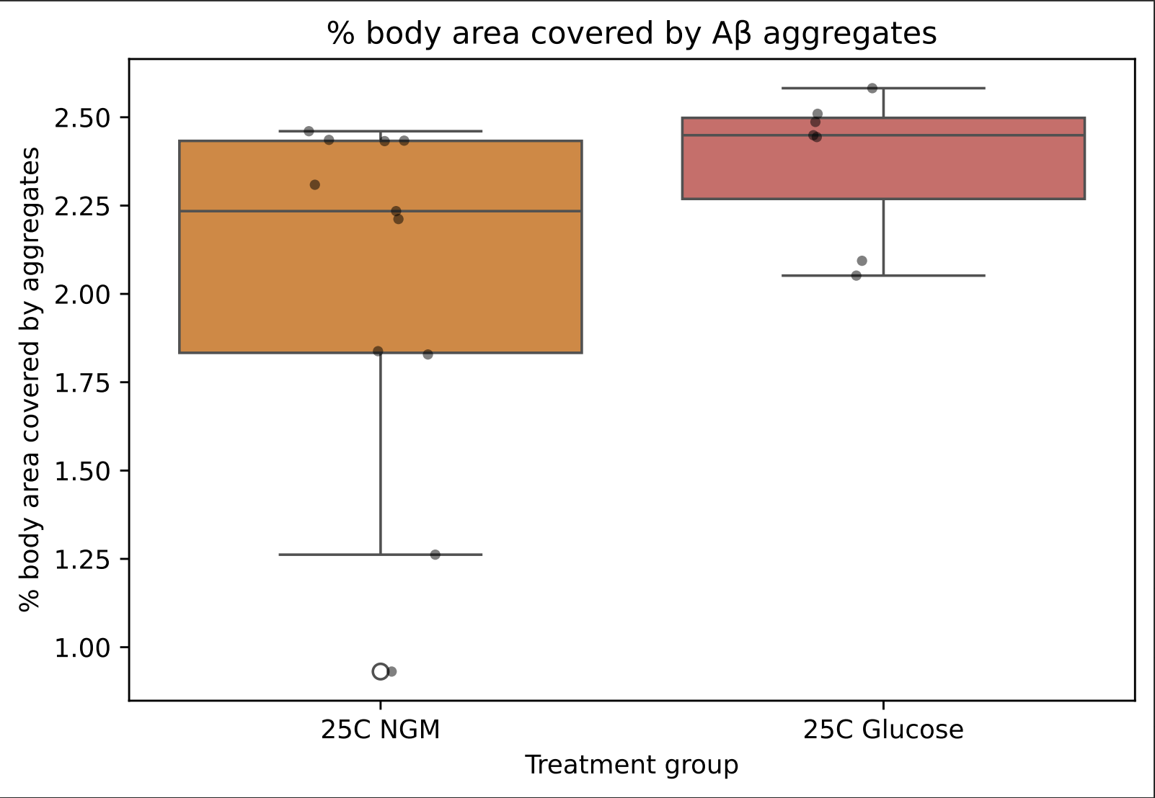
Aggregate Imaging Results
Aggregate burden was similar across groups
Glucose did not visibly increase plaque accumulation
Microscopy supported graph findings
Kruskal Wallis test
Kruskal Wallis test
Notes:
Victoria
For imaging data, we used the Kruskal Wallis test because the sample size was smaller and the data were not ideally suited for a parametric test.
The results showed no significant increase in aggregate burden in the glucose treated worms. Aggregate intensity and body coverage were generally similar across groups.

Slide 19
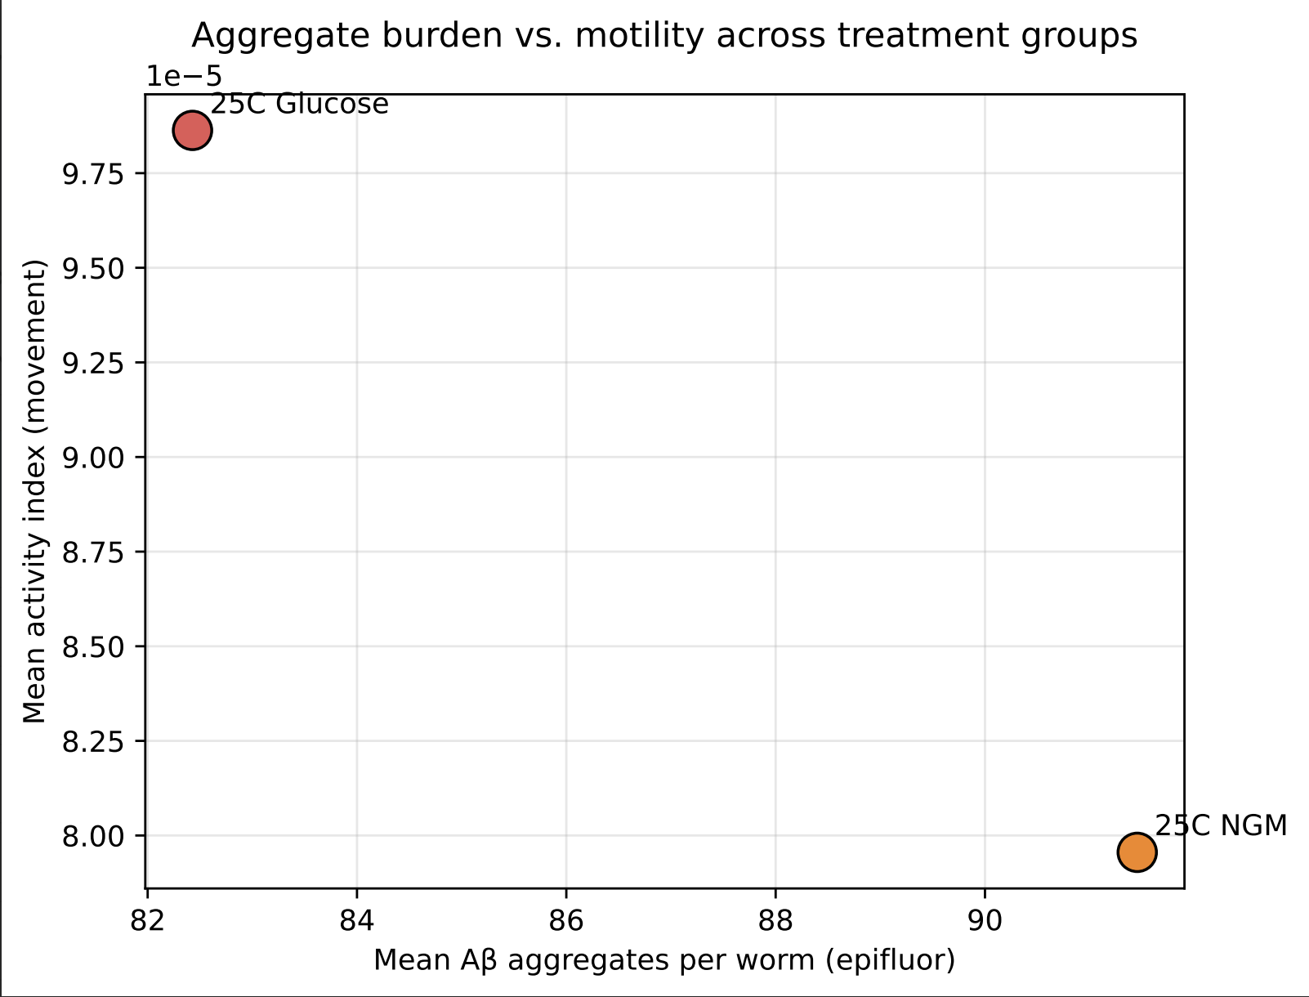
Relationship Between Aggregates and Movement
More aggregates did not equal worse movement
Aggregate presence alone may not predict behavioral decline
Spearman rank correlation
Notes:
Victoria
To examine whether aggregate burden was linked to movement decline, we compared imaging and behavioral data.
We did not observe a strong relationship between greater aggregate presence and reduced motility, suggesting that aggregate load alone may not directly predict early behavioral decline.
NOTE:
what statistically significant means: the difference was unlikely to be caused by random variation alone.
If asked why no p values on screen: We summarized the main findings visually, but full statistical outputs are available if you'd like to discuss them.

Slide 20
Results Overview
Glucose did not significantly increase Aβ aggregates
Glucose did not worsen paralysis metrics
Temperature had strongest effect on movement.
“cold-torpor”
Aggregate burden did not directly match motility
Notes:
Victoria
Overall, our data suggest that glucose did not significantly worsen Aβ aggregation under these conditions, while temperature had the clearest effect on worm movement.
Our clearest finding was that glucose did not produce the expected increase in aggregation or paralysis during the measured timepoints. Instead, temperature had the strongest observable effect on movement.

Slide 21
Was Our Hypothesis Supported?
Hypothesis not supported
Predicted glucose would increase Aβ burden
Data did not show significant glucose effect
Notes:
Lauren
Our original hypothesis predicted that glucose exposure would increase beta amyloid aggregation and worsen behavioral decline. Based on the data we collected, that hypothesis was not supported under the conditions tested.
However, disproving a hypothesis is still valuable scientific information. Scientific progress depends on testing predictions objectively, even when results differ from expectations.
In our case, the findings suggest that early or short term glucose exposure may not be sufficient to create measurable differences during the time window we analyzed.
Although our original hypothesis was not supported, disproving a hypothesis is still valuable scientific information because it helps refine future questions.
Helps narrow future directions…
Results don’t always match predictions - we know this.

Slide 22
Implications + Relation to Previous Research
Suggests glucose effects may depend on timing or duration
Early exposure alone may be insufficient
Adds nuance to prior sugar and AD studies
Notes:
Lauren
Previous studies have linked high sugar intake to neurodegeneration and increased Alzheimer’s related pathology. Our findings do not necessarily contradict that research, but they may help refine it.
Our findings suggest that brief glucose exposure alone may not be enough to immediately trigger measurable Alzheimer’s related pathology. This reflects an important reality of many chronic diseases, where damage often develops gradually through cumulative stress rather than a single short exposure
Instead, our data suggest that timing and duration of exposure could be important variables. Short early exposure may not produce the same effects as chronic or long term metabolic stress.
This helps advance the discussion by showing that not only sugar amount, but also exposure timeline, may influence disease related outcomes
For the public, this does not mean sugar is harmless or previous studies were incorrect. Instead, it suggests health risk may be driven more by long term patterns of diet rather than isolated short exposures. It also reinforces that diseases like Alzheimer’s are multifactorial, meaning diet may interact with aging, genetics, and other lifestyle factors.
Our results help separate the concepts of exposure presence from exposure duration. Simply being exposed to glucose may not be enough. How long the organism experiences that metabolic stress may be the more important variable.
Our data also suggest that visible aggregate burden and behavioral decline may not occur on the same timeline. Molecular changes and movement changes may emerge at different stages.
Many people think disease risk changes immediately after one unhealthy behavior. Our results support the idea that chronic diseases are usually built over time
Previous studies linked sugar to neurodegeneration. Our findings suggest that short term or early exposure may not be enough to produce measurable effects at Days 2 to 3.

Slide 23
Conclusion
Glucose showed no early detectable increase in Aβ burden
Timing may matter more than presence alone
Negative results can guide stronger future research
Notes:
Victoria
This helps narrow future directions

Slide 24
Limitations + Sources of Error
Small sample sizes
Lack of Day 9 imaging dataset
15°C reduced movement naturally
Limited imaging groups for epifluorescence
Notes:
Victoria
One major limitation was that our Day 9 imaging set, where stronger paralysis was expected, was unavailable for final comparison. That later timepoint may have revealed changes not visible at earlier stages.
Additional limitations include sample size, biological variability between worms, and the short experimental window.
If given more time, we would extend glucose exposure, increase replicate number, include later imaging checkpoints, and perform additional behavioral assays. Those changes could help determine whether effects emerge over longer disease progression.
One major limitation was that Day 9 imaging, where stronger paralysis was expected, was unavailable. That later timepoint may have revealed effects not visible earlier.

Slide 25
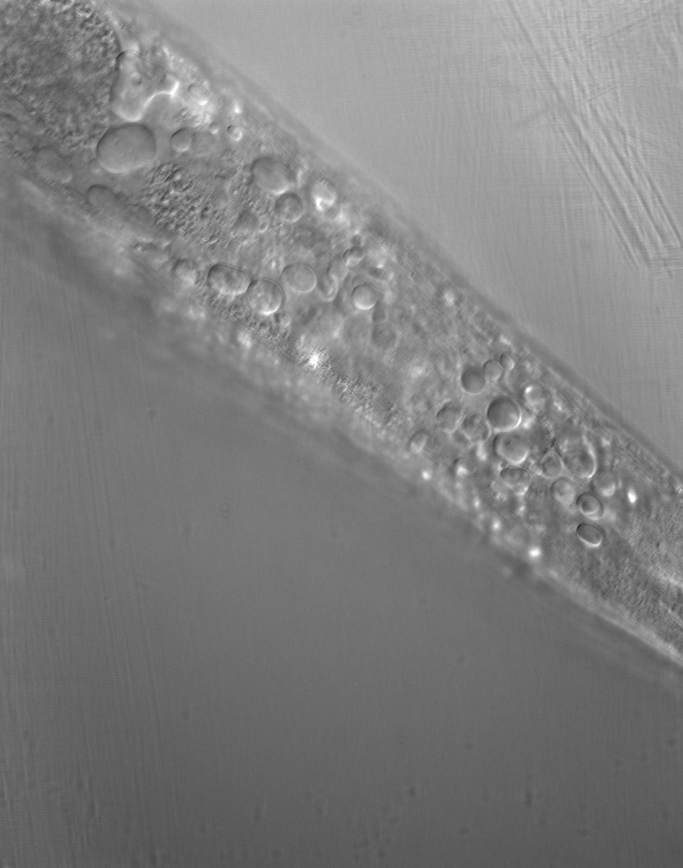
Future Modifications / Next Experiments
Collect full Day 9 imaging data
Test longer glucose exposure durations
Compare glucose vs fructose vs sucrose
Increase sample size
Measure age specific exposure windows
Notes:
Victoria
Our best next step would be extending imaging and movement analysis into later adulthood, where pathology may become more pronounced.
This helps narrow future directions
[INSERT DIC IMAGE OF WORM WITH LIPID BUBBLES]

Slide 26
Agarwal, P., Ford, C. N., Leurgans, S. E., Beck, T., Desai, P., Dhana, K., Evans, D. A., Halloway, S., Holland, T. M., Krueger, K. R., Liu, X., Rajan, K. B., & Bennett, D. A. (2023). Dietary Sugar Intake Associated with a Higher Risk of Dementia in Community-Dwelling Older Adults. Journal of Alzheimer's disease : JAD, 95(4), 1417–1425. https://doi.org/10.3233/JAD-230013
Baranowski, B. J., Bott, K. N., & MacPherson, R. E. K. (2018). Evaluation of neuropathological effects of a high-fat high-sucrose diet in middle-aged male C57BL6/J mice. Physiological reports, 6(11), e13729. https://doi.org/10.14814/phy2.13729
Breijyeh, Z., & Karaman, R. (2020). Comprehensive Review on Alzheimer's Disease: Causes and Treatment. Molecules (Basel, Switzerland), 25(24), 5789. https://pmc.ncbi.nlm.nih.gov/articles/PMC7764106/
Chen, Y., & Yu, Y. (2023). Tau and neuroinflammation in Alzheimer's disease: interplay mechanisms and clinical translation. Journal of neuroinflammation, 20(1), 165. https://pmc.ncbi.nlm.nih.gov/articles/PMC10349496/
Fatafta, H., Khaled, M., Owen, M. C., Sayyed-Ahmad, A., & Strodel, B. (2021). Amyloid-β peptide dimers undergo a random coil to β-sheet transition in the aqueous phase but not at the neuronal membrane. Proceedings of the National Academy of Sciences of the United States of America, 118(39), 1–10. https://www.jstor.org/stable/27075836
Kellar, D., & Craft, S. (2020). Brain insulin resistance in Alzheimer's disease and related disorders: mechanisms and therapeutic approaches. The Lancet. Neurology, 19(9), 758–766. https://pmc.ncbi.nlm.nih.gov/articles/PMC9661919/
Lattanzi, V., André, I., Gasser, U., Dubackic, M., Olsson, U., & Linse, S. (2021). Amyloid β 42 fibril structure based on small-angle scattering. Proceedings of the National Academy of Sciences, 118(48), e2112783118. https://doi.org/10.1073/pnas.2112783118
Lublin, A. L., Link, C. D., & Luke, C. J. (2011). In vivo screening using Caenorhabditis elegans as a model for β-amyloid peptide–related Alzheimer’s disease. Biotechnology Journal, 7(2), 201–211. https://doi.org/10.1016/j.nbt.2012.01.006
O'Brien, R. J., & Wong, P. C. (2011). Amyloid precursor protein processing and Alzheimer's disease. Annual review of neuroscience, 34, 185–204. https://pmc.ncbi.nlm.nih.gov/articles/PMC3174086/
Notes:
Victoria

Slide 27
Porta-de-la-Riva, M., Fontrodona, L., Villanueva, A., & Cerón, J. (2012). Basic Caenorhabditis elegans methods: synchronization and observation. Journal of visualized experiments : JoVE, (64), e4019. https://doi.org/10.3791/4019
Rodríguez-Antolín, J., Cervantes-Rodríguez, M., Cuevas, E., & Nicolás-Toledo, L. (2017, October 15–20). Gestational protein restriction plus rich-sucrose diet in adulthood promotes affectations in liver of rats [Conference poster abstract]. Annals of Nutrition & Metabolism, 71(Suppl 2), 429. https://www.jstor.org/stable/10.2307/48507370
Sharma, K., Thirumalai, D., Sharma, A., Shikha, M., Ajeet, K., Shankar, J., & Shukla, A. K. (2023). In the quest for the ideal sweetener: Aspartame exacerbates selected biomarkers in the fruit fly (Drosophila melanogaster) model of Alzheimer’s disease more than sucrose. Frontiers in Nutrition, 10, 1195466. https://doi.org/10.3389/fnut.2023.1195466
Taylor, H. B. C., Emptage, N. J., & Jeans, A. F. (2021). Long-term depression links amyloid-β to the pathological hyperphosphorylation of tau. Cell reports, 36(9), 109638. https://pmc.ncbi.nlm.nih.gov/articles/PMC8424646/
Taylor, M. K., Sullivan, D. K., Swerdlow, R. H., Vidoni, E. D., Morris, J. K., Mahnken, J. D., & Burns, J. M. (2017). A high-glycemic diet is associated with cerebral amyloid burden in cognitively normal older adults. The American journal of clinical nutrition, 106(6), 1463–1470. https://doi.org/10.3945/ajcn.117.162263
Tijanap. (n.d.). Food for thought. Food in shape of a brain [Stock photograph]. Dreamstime. https://www.dreamstime.com/stock-photography-food-shape-brain-image29936792
Notes:
Victoria

Slide 28
Toseland C. P. (2013). Fluorescent labeling and modification of proteins. Journal of chemical biology, 6(3), 85–95. https://doi.org/10.1007/s12154-013-0094-5 van Gils, V., Rizzo, M., Côté, J., Viechtbauer, W., Fanelli, G., Salas-Salvadó, J., Wimberley, T., Bulló, M., Fernandez-Aranda, F., Dalsgaard, S., Visser, P. J., Jansen, W. J., & Vos, S. J. B. (2024). The association of glucose metabolism measures and diabetes status with Alzheimer's disease biomarkers of amyloid and tau: A systematic review and meta-analysis. Neuroscience and biobehavioral reviews, 159, 105604. https://doi.org/10.1016/j.neubiorev.2024.105604
Wei, Z., Koya, J., & Reznik, S. E. (2021). Insulin Resistance Exacerbates Alzheimer Disease via Multiple Mechanisms. Frontiers in neuroscience, 15, 687157. https://pubmed.ncbi.nlm.nih.gov/34349617/
Yeung, C. H. C., Lau, K. W. D., Yeung, S. L. A., & Schooling, C. M. (2021). Amyloid, tau and risk of Alzheimer’s disease: a Mendelian randomization study. European Journal of Epidemiology, 36(1), 81–88. https://www.jstor.org/stable/48764413
Notes:
Victoria

Slide 29



Dr. David Katz (Emory University)
Mackenzie Roberson (Emory University)
Monica Reeves (Emory University)
Dr. Michelle Mondoux (Holy Cross)
Dr. Karen Schmeichel (Oglethorpe University)
Dr. Peng Jin (Emory University)
Dr. Danielle Mor (Augusta University)
Dr. Jessica Hartman (Medical University of South Carolina)
Acknowledgements
Notes:
Victoria

Slide 30
Thank you for listening!
Questions?
Notes:
Victoria

